Slide 1
Solve The Maze
Guided by:
S.K. Singh Sir
Submitted by:
Lokesh Bhoyar,
Lalit Mandloi,
Raghwendra Meena,
Anuj Kumar
CSE I-year
Sem-II

Slide 2
INTRODUCTION
In graph theory, the shortest path problem is the problem of finding a path between two vertices (or nodes) in a graph such that the sum of the weights of its constituent edges is minimized.
The problem of finding the shortest path between two intersections on a road map (the graph's vertices correspond to intersections and the edges correspond to road segments, each weighted by the length of its road segment) may be modelled by a special case of the shortest path problem in graphs.

Slide 3
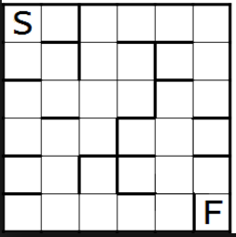
PROBLEM STATEMENT
SOLVE THE MAZE
Given a maze you are supposed to travel from start to finish node using the shortest path. Solve the problem using Dijkstra’s algorithm. Solution must be adaptable to similar problems

Slide 4
methodology
Dijkstra's algorithm is an algorithm for finding the shortest path between nodes in a graph, which may represent, for example, road networks. It was conceived by computer scientist Edsger W. Dijkstra in 1956 and published three years later.
The algorithm exists in many variants; Dijkstra's original variant found the shortest path between two nodes, but a more common variant fixes a single node as the "source" node and finds shortest paths from the source to all other nodes in the graph, producing a shortest-path tree.
For a given source node in the graph, the algorithm finds the shortest path between that node and every other. It can also be used for finding the shortest paths from a single node to a single destination node by stopping the algorithm once the shortest path to the destination node has been determined. For example,
if the nodes of the graph represent cities and edge path costs represent driving distances between pairs of cities connected by a direct road, Dijkstra's algorithm can be used to find the shortest route between one city and all other cities.

Slide 5
Dijkstra’s algorithm solves the single-source shortest-paths problem on a weighted, directed graph G =(V,E) for the case in which all edge weights are non negative. Therefore, we assume that w(u,v) >= 0 for each edge (u , v) Є E. Dijkstra’s algorithm maintains a set S of vertices whose ﬁnal shortest-path weights from the source s have already been determined. The algorithm repeatedly selects the vertex u Є V - S with the minimum shortest-path estimate, adds u to S, and relaxes all edges leaving u. In the following implementation, we use a min-priority queue Q of vertices, keyed by their d values.

Slide 6
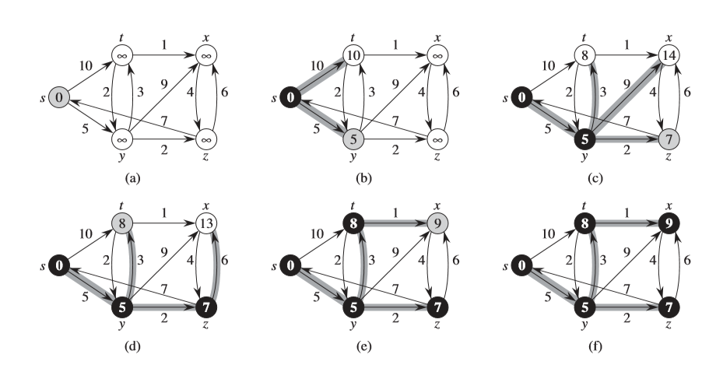
The execution of Dijkstra’s algorithm. The source s is the leftmost vertex. The shortest-path estimates appear within the vertices, and shaded edges indicate predecessor values. Black vertices are in the set S, and white vertices are in the min-priority queue Q=V-S . (a) The situation just before the ﬁrst iteration of the while loop of lines 4–8. The shaded vertex has the minimum d value and is chosen as vertex u in line 5. (b)–(f) The situation after each successive iteration of the while loop. The shaded vertex in each part is chosen as vertex u in line 5 of the next iteration. The d values and predecessors shown in part (f) are the ﬁnal values.

Slide 7
Algorithm
Let the node at which we are starting be called the initial node. Let the distance of node Y be the distance from the initial node to Y. Dijkstra's algorithm will assign some initial distance values and will try to improve them step by step.
Assign to every node a tentative distance value: set it to zero for our initial node and to infinity for all other nodes.
Set the initial node as current. Mark all other nodes unvisited. Create a set of all the unvisited nodes called the unvisited set.
For the current node, consider all of its unvisited neighbors and calculate their tentative distances. Compare the newly calculated tentative distance to the current assigned value and assign the smaller one. For example, if the current node A is marked with a distance of 6, and the edge connecting it with a neighbor B has length 2, then the distance to B (through A) will be 6 + 2 = 8. If B was previously marked with a distance greater than 8 then change it to 8. Otherwise, keep the current value.

Slide 8
4. When we are done considering all of the neighbors of the current node, mark the current node as visited and remove it from the unvisited set. A visited node will never be checked again.
If the destination node has been marked visited (when planning a route between two specific nodes) or if the smallest tentative distance among the nodes in the unvisited set is infinity (when planning a complete traversal; occurs when there is no connection between the initial node and remaining unvisited nodes), then stop. The algorithm has finished.
6. Otherwise, select the unvisited node that is marked with the smallest tentative distance, set it as the new "current node", and go back to step 3.

Slide 9
pSeuDOCODE
1 function Dijkstra(Graph, source):
2 create vertex set Q
3 for each vertex v in Graph: // Initialization
4 dist[v] ← INFINITY // Unknown distance from source to v
5 prev[v] ← UNDEFINED // Previous node in optimal path from source
6 add v to Q // All nodes initially in Q (unvisited nodes)
7 dist[source] ← 0 // Distance from source to source
8 while Q is not empty:
9 u ← vertex in Q with min dist[u] // Source node will be selected first
10 remove u from Q
11 for each neighbor v of u: // where v is still in Q.
12 alt ← dist[u] + length(u, v)
13 if alt < dist[v]: // A shorter path to v has been found
14 dist[v] ← alt
15 prev[v] ← u
16 return dist[], prev[]

Slide 10
Code1 ..\DS Assignment Group 5\AssignmentP5_Graphics.cpp
Code2 Dijkashtra,s Algo using matrix.CPP

Slide 11
traversal
2
Initialize array
F
3
5
C
 | K | d_{v} | p_{v}
A | F | ∞ | −
B | F | ∞ | −
C | F | ∞ | −
D | F | ∞ | −
E | F | ∞ | −
F | F | ∞ | −
G | F | ∞ | −
H | F | ∞ | −
A
10
7
3
8
4
4
B
18
D
9
10
H
2
9
25
3
G
E
7

Slide 12
2
Start with G
F
3
5
C
 | K | d_{v} | p_{v}
A
B
C
D
E
F
G | T | 0 | −
H
A
10
7
3
8
4
4
B
18
D
9
10
H
2
9
25
3
G
E
7

Slide 13
2
Update unselected nodes
F
3
5
C
 | K | d_{v} | p_{v}
A
B
C
D |  | 2 | G
E
F
G | T | 0 | −
H |  | 3 | G
A
10
7
3
8
4
4
B
18
D
9
10
H
2
9
25
3
G
E
7

Slide 14
2
Select minimum distance
F
3
5
C
 | K | d_{v} | p_{v}
A
B
C
D | T | 2 | G
E
F
G | T | 0 | −
H |  | 3 | G
A
10
7
3
8
4
4
B
18
D
9
10
H
2
9
25
3
G
E
7

Slide 15
2
Update unselected nodes
F
3
5
C
 | K | d_{v} | p_{v}
A
B
C
D | T | 2 | G
E |  | 27 | D
F |  | 20 | D
G | T | 0 | −
H |  | 3 | G
A
10
7
3
8
4
4
B
18
D
9
10
H
2
9
25
3
G
E
7

Slide 16
2
Select minimum distance
F
3
5
C
 | K | d_{v} | p_{v}
A
B
C
D | T | 2 | G
E |  | 27 | D
F |  | 20 | D
G | T | 0 | −
H | T | 3 | G
A
10
7
3
8
4
4
B
18
D
9
10
H
2
9
25
3
G
E
7

Slide 17
2
Update unselected nodes
F
3
5
C
 | K | d_{v} | p_{v}
A |  | 7 | H
B |  | 12 | H
C
D | T | 2 | G
E |  | 27 | D
F |  | 20 | D
G | T | 0 | −
H | T | 3 | G
A
10
7
3
8
4
4
B
18
D
9
10
H
2
9
25
3
G
E
7

Slide 18
2
Select minimum distance
F
3
5
C
 | K | d_{v} | p_{v}
A | T | 7 | H
B |  | 12 | H
C
D | T | 2 | G
E |  | 27 | D
F |  | 20 | D
G | T | 0 | −
H | T | 3 | G
A
10
7
3
8
4
4
B
18
D
9
10
H
2
9
25
3
G
E
7

Slide 19
2
Update unselected nodes
F
3
5
C
 | K | d_{v} | p_{v}
A | T | 7 | H
B |  | 12 | H
C
D | T | 2 | G
E |  | 27 | D
F |  | 17 | A
G | T | 0 | −
H | T | 3 | G
A
10
7
3
8
4
4
B
18
D
9
10
H
2
9
25
3
G
E
7

Slide 20
2
Select minimum distance
F
3
5
C
 | K | d_{v} | p_{v}
A | T | 7 | H
B | T | 12 | H
C
D | T | 2 | G
E |  | 27 | D
F |  | 17 | A
G | T | 0 | −
H | T | 3 | G
A
10
7
3
8
4
4
B
18
D
9
10
H
2
9
25
3
G
E
7

Slide 21
2
Update unselected nodes
F
3
5
C
 | K | d_{v} | p_{v}
A | T | 7 | H
B | T | 12 | H
C |  | 16 | B
D | T | 2 | G
E |  | 22 | B
F |  | 17 | A
G | T | 0 | −
H | T | 3 | G
A
10
7
3
8
4
4
B
18
D
9
10
H
2
9
25
3
G
E
7

Slide 22
2
Select minimum distance
F
3
5
C
 | K | d_{v} | p_{v}
A | T | 7 | H
B | T | 12 | H
C | T | 16 | B
D | T | 2 | G
E |  | 22 | B
F |  | 17 | A
G | T | 0 | −
H | T | 3 | G
A
10
7
3
8
4
4
B
18
D
9
10
H
2
9
25
3
G
E
7

Slide 23
2
Update unselected nodes
F
3
5
C
 | K | d_{v} | p_{v}
A | T | 7 | H
B | T | 12 | H
C | T | 16 | B
D | T | 2 | G
E |  | 22 | B
F |  | 17 | A
G | T | 0 | −
H | T | 3 | G
A
10
7
3
8
4
4
B
18
D
9
10
H
2
9
25
3
G
E
7

Slide 24
2
Select minimum distance
F
3
5
C
 | K | d_{v} | p_{v}
A | T | 7 | H
B | T | 12 | H
C | T | 16 | B
D | T | 2 | G
E |  | 22 | B
F | T | 17 | A
G | T | 0 | −
H | T | 3 | G
A
10
7
3
8
4
4
B
18
D
9
10
H
2
9
25
3
G
E
7

Slide 25
2
Update unselected nodes
F
3
5
C
 | K | d_{v} | p_{v}
A | T | 7 | H
B | T | 12 | H
C | T | 16 | B
D | T | 2 | G
E |  | 19 | F
F | T | 17 | A
G | T | 0 | −
H | T | 3 | G
A
10
7
8
4
4
B
18
D
9
10
H
2
9
25
3
G
E
7

Slide 26
2
Select minimum distance
F
3
5
C
 | K | d_{v} | p_{v}
A | T | 7 | H
B | T | 12 | H
C | T | 16 | B
D | T | 2 | G
E | T | 19 | F
F | T | 17 | A
G | T | 0 | −
H | T | 3 | G
A
10
7
8
4
4
B
18
D
9
10
H
2
9
25
3
G
E
7
Done

Slide 27
Critical analysis
Using BFS Traversal ,the time consumed for Dijkstra's algorithm is defined by,
T(n)= Ɵ(1) if n<c
aT(n/b) otherwise
Where T(n) = n log n
And memory consumption is n for total nodes and c for other variables.
Using Adjacency Matrix, The time consumed by Dijkstra's algorithm is defined by,
T(n)= Ɵ(1) if n<c
aT(nb) otherwise
Where T(n) = n²
And memory consumption is n² for totals nodes and c for other variables.

Slide 28
results
Dijkstra's algorithm using BFS is suitable method to find the shortest ‘distance and path’ between Source(1) to Destination(n) in maze .
Weight of edges in Dijkstra’s algorithm must be non negative to get actual shortest path.

